Slide 1




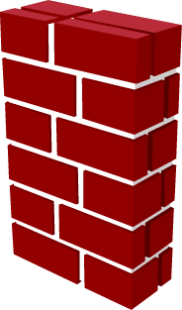
Current state
vnet2
vng2-vnet
10.2.0.0/24
10.2.1.0/24
2
Vnet
peer
21
10.2.0.0/16
VNG2
Represents
SD-WAN site
Internet
IPsec
BGP peering
Represents
Production Vnet
vnet1
10.1.0.0/24
10.1.1.0/24
Vnet
peer
VNG1
1
11
10.1.0.0/16
Inside
NIC
VM100
Internet
Represents
CP FW cluster
vng1-vnet
Connectivity requirements:
SD-WAN <> Production Vnet
Production Vnet <> Internet

